Slide 1
Performance Analysis of a 4-bit Ripple Carry Adder (RCA) formed using Static CMOS, Transmission Gate, NMOS Pass Transistor Logic at gpdk 180nm Technology node.
EL526 vlsi system design
Presented by: Anupam Mathur

Slide 2
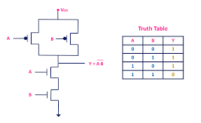
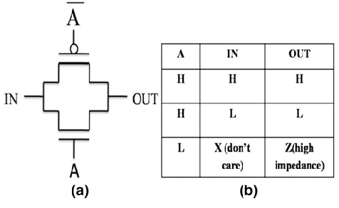
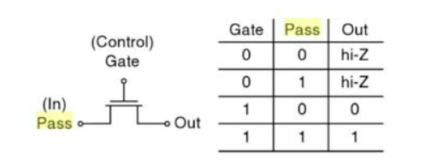
Logic Types
Static CMOS Logic
Transmission Gate Logic
NMOS PTL
Full Rail to Rail Swing
Least Average Power Consumption
Passes weak logic HIGH
(Vout = Vdd-Vthn)

Slide 3
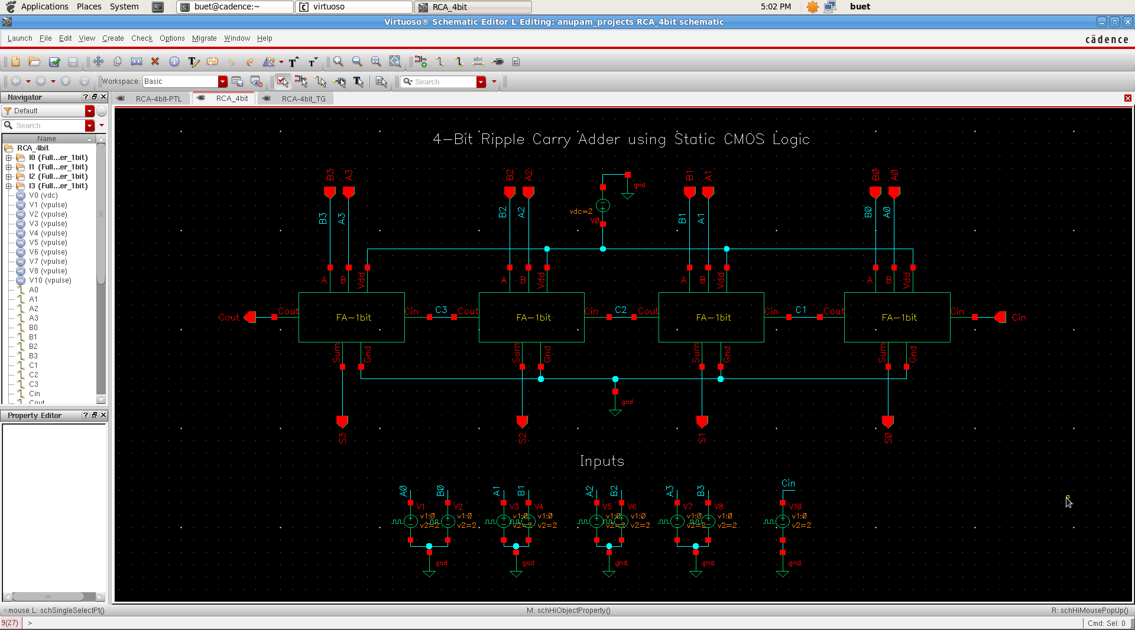
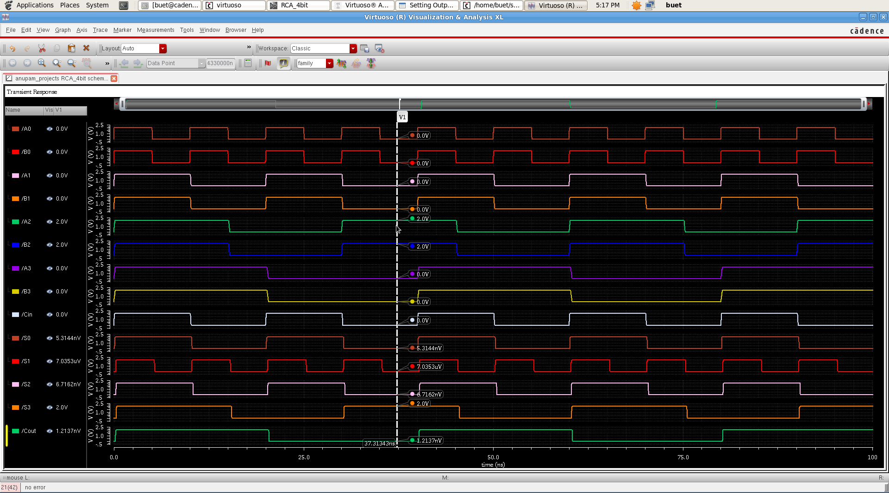
4-bit Ripple Carry Adder using Static CMOS Logic

Slide 4
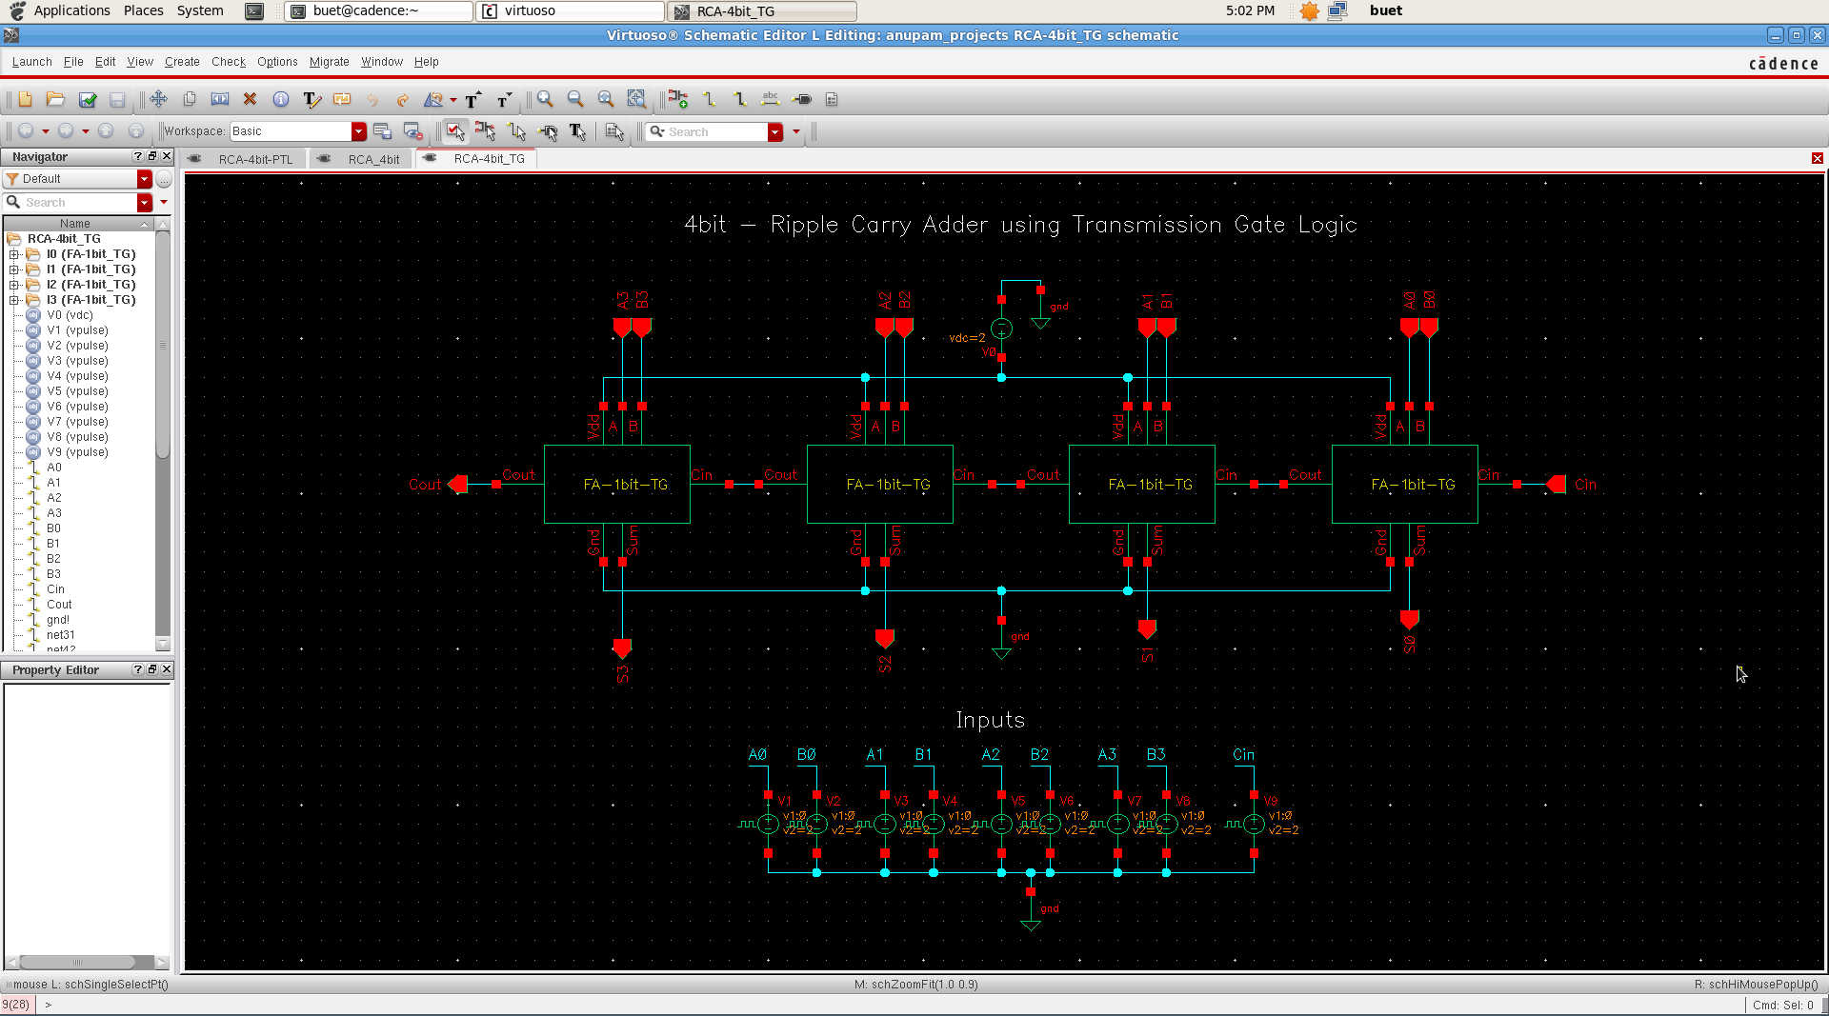
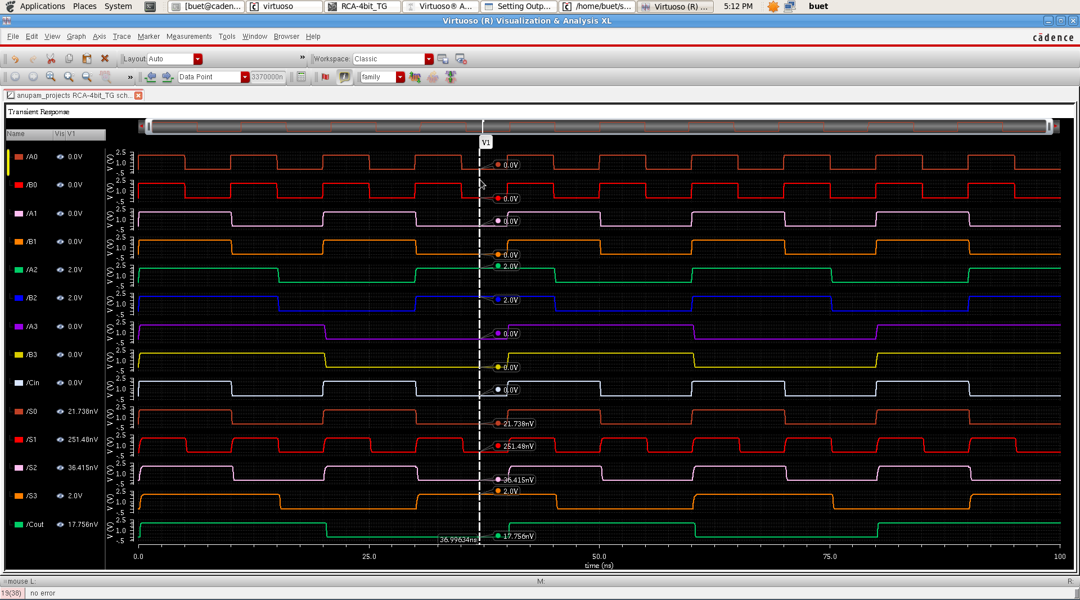
4-bit Ripple Carry Adder using Transmission Gate Logic

Slide 5
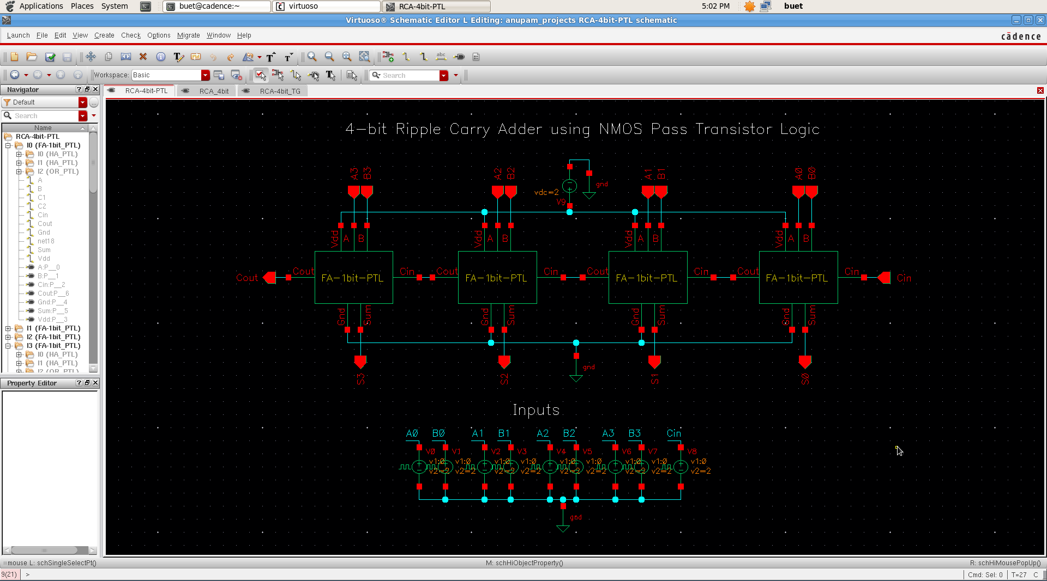
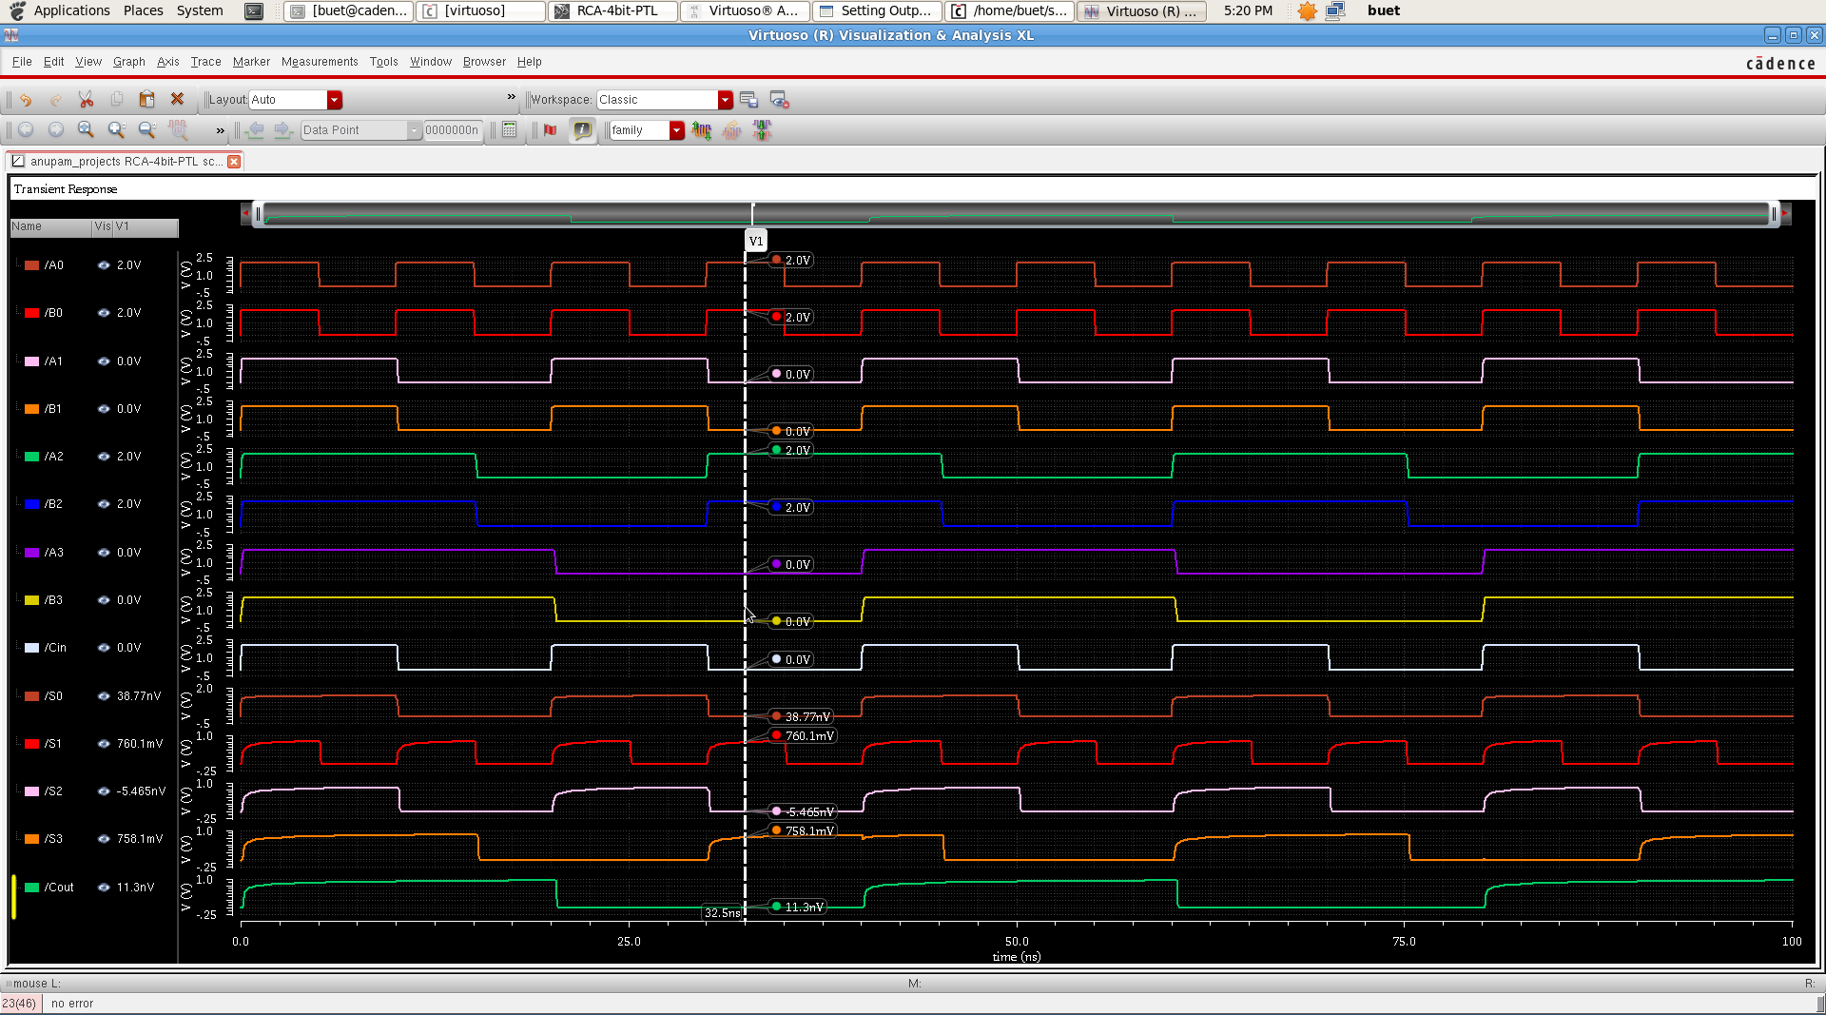
4-bit Ripple Carry Adder using NMOS Pass Transistor Logic

Slide 6
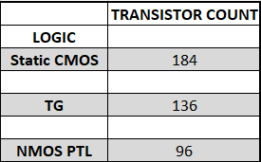
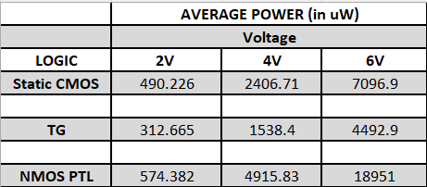
Results

Slide 7
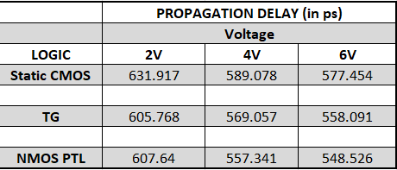
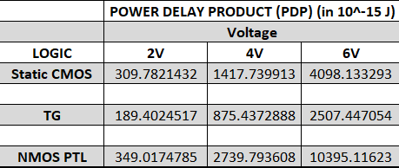
Results

Slide 8
THANK YOU!

